Slide 1
Professional Profile Presentation
Janie Shin

Slide 2
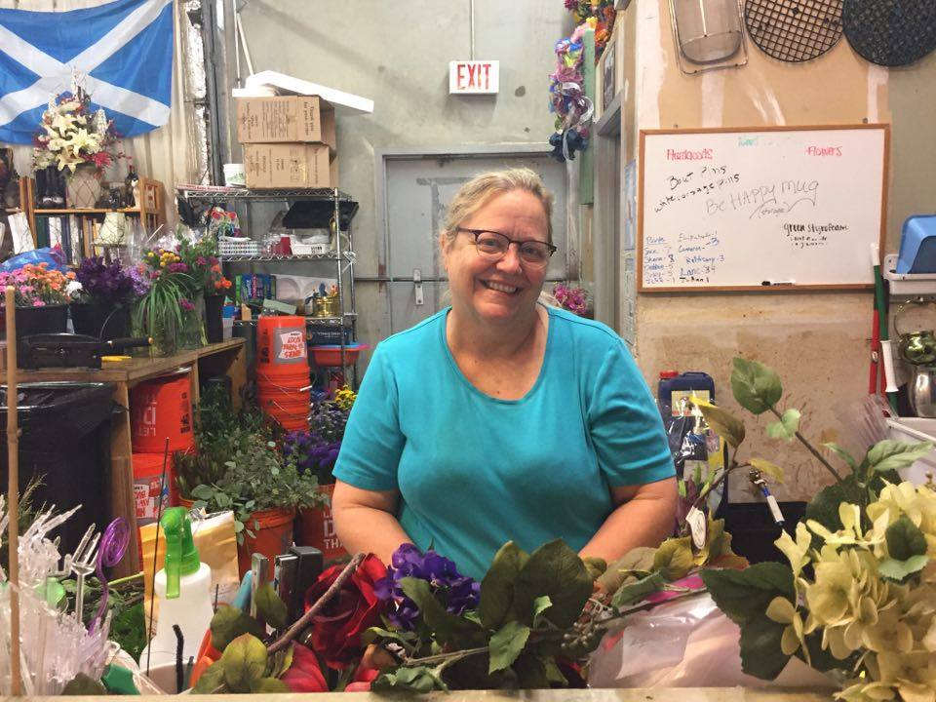
About
Debbie Brooks
Position: Owner/designer
How long: Owned business for 30 years
Prior experience: Floral design classes at A&M, 5 years in a different floral shop in College Station
Education: 4 years at A&M (enrolled 1980s)
Major: Changed from Food Technology major to Floral Design
But not graduated due to starting a family
Started her own business

Slide 3
About the job position
“ You never know what’s going to happen.”
Not a low stress job
The day I interviewed:
Was working on personal flowers as well as a cemetery decoration,
1-2 appointments with people
design, order, and talk
work on games during the weekend
4 weddings
Busy months: April May and Valentines Day (crazy week)

Slide 4
Skills needed
“You need to know how to lift weights”
Have to lift buckets weighing around 45 lbs. every day
Social skills
Know how to communicate with customers on what they want
People skills
During days with emotional events with customers (funerals) know how to control your emotions and get things done

Slide 5
Qualities needed for job
People person (customers and coworkers)
“INITIATIVE” given a list and know how to get it done
Artistic ability
Ex: One of her old employees didn’t know how to make a basic bud vase and had to be taught by 3 different people and at the end had to be let go
Don’t think floral design is a “part-time” job
Don’t play around

Slide 6
Advice for future florists
Hard job
Find a good clientele
Know your business
Have background of both business and artistic ability
Know your artistic end and grow that to your best ability
Design even if you are the owner

Slide 7
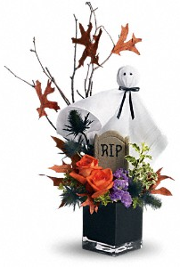
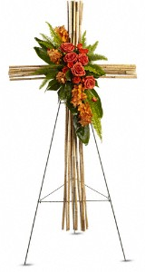
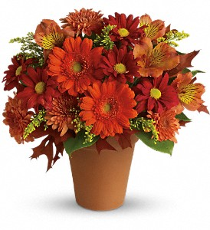
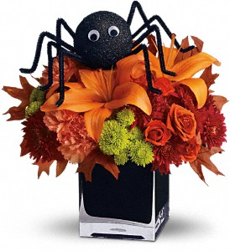
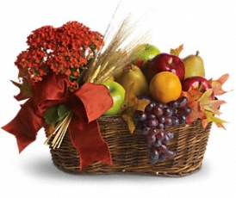
Questions?
Halloween theme
Fall theme
Sympathy piece

