Slide 1
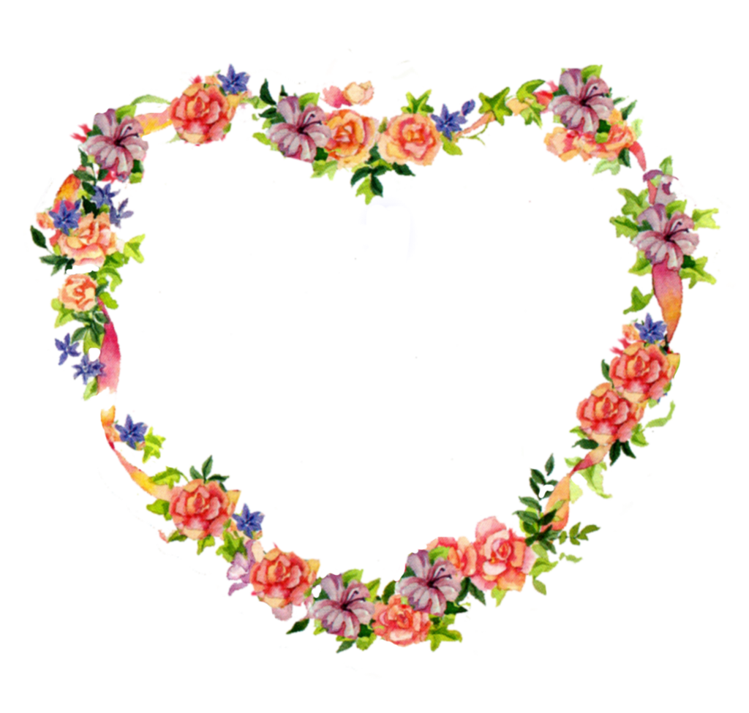
Design Portfolio
Janie Shin
Hort 203 - 102

Slide 2
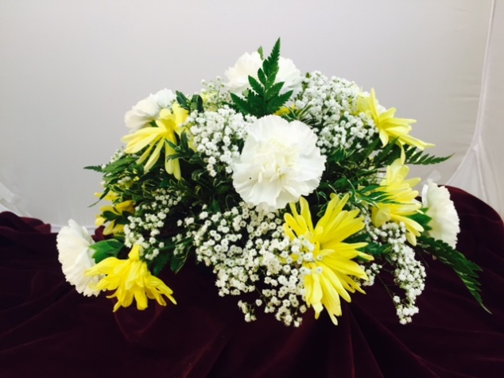
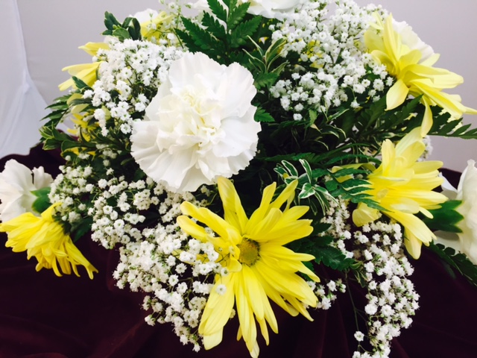
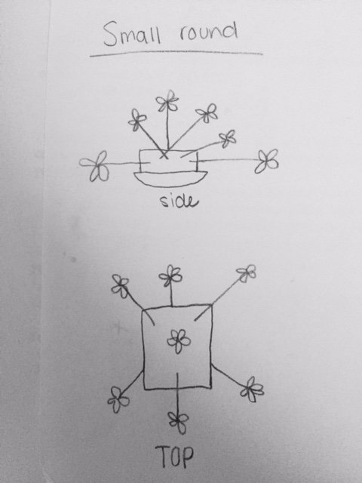
Small Round
Elements: I really like the colors of this design. The white of the carnations and babies breath go really well with the bright yellow of the Daisy Pompon mums.
Principle: I like the rhythm. The repetition of the daisies and carnations helps balance out the design and makes it look very uniform.
List of plant materials: Carnation, Daisy Pompon Chrysanthemum, Baby’s Breath, Oregonia and Leatherleaf

Slide 3
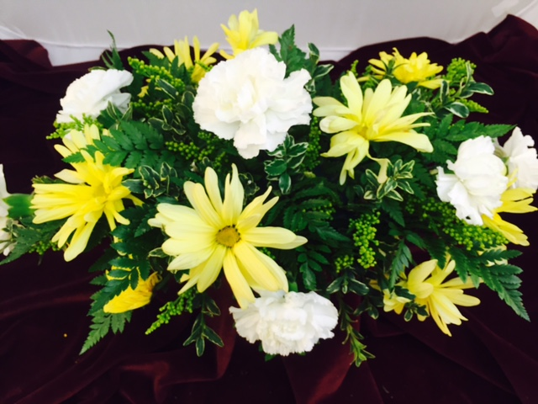
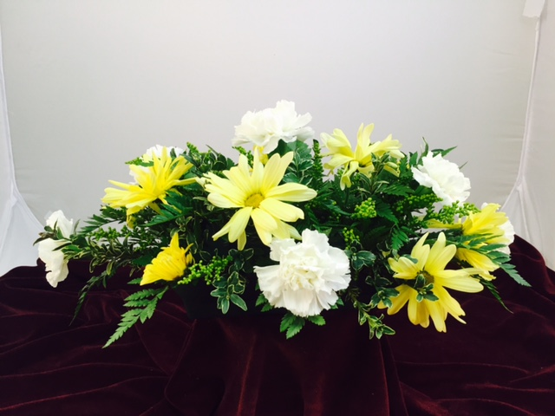
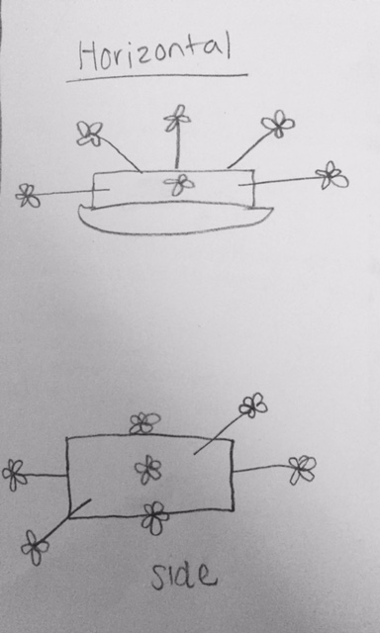
Horizontal
Elements: I really like the line of this design. The daisies and carnation help eye follow a pathway and produces movement.
Principles: I like the unity in this design. The flowers blend well together without it being too rough and colors work well with one another.
Plant materials: Carnation, Daisy Pompon Chrysanthemum, Goldenrod, Oregonia and Leatherleaf

Slide 4
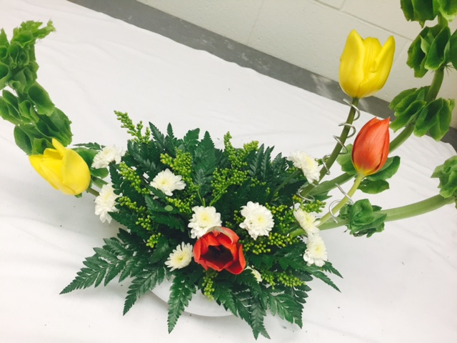
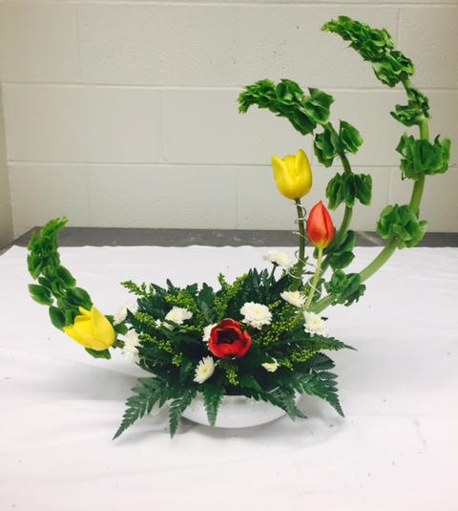
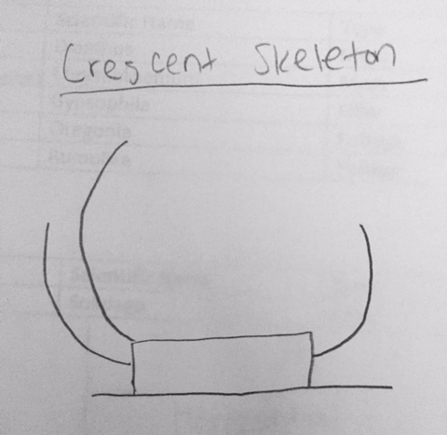
Crescent
Plant materials: Bells of Ireland, mums, leatherleaf and Tulips
Elements: I love the space in this design. The way the bells of Ireland creates space around the design by making the crescent shape looks really cool.
Principles: I like the asymmetrical balance of this design. How one side isn’t a mirror image of the other but the arrangements of the pieces help balance the design out.

Slide 5
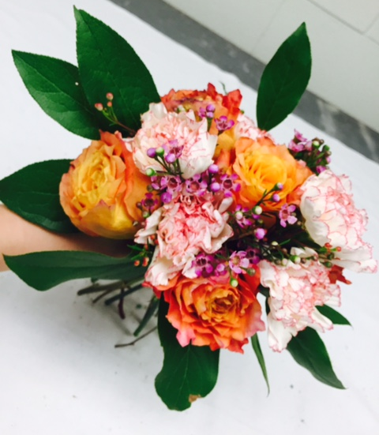
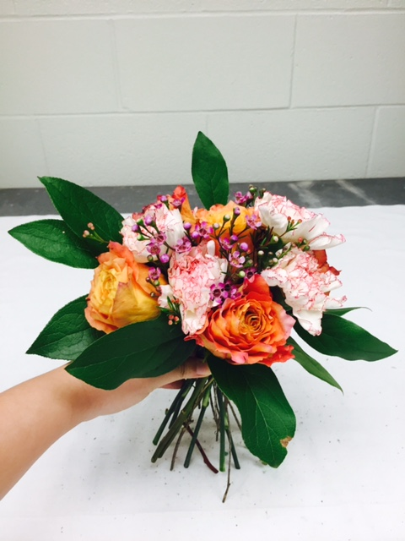
Hand Tied Bouquet
Elements: I really like the different textures in this design. The feminine and smooth textures of the roses and carnations go really well with the rough textures of the salal.
Principle: I love the harmony in this design. The colors of this piece create a warm and delicate feel while the foliage give a sense of nature. They work well together.
Plant materials: Rose, waxflower, carnations, and salal

Slide 6
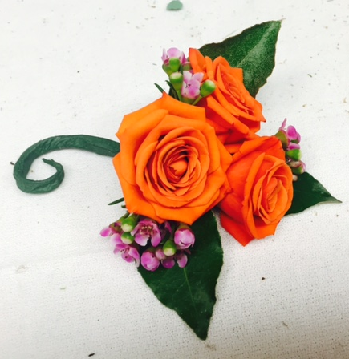
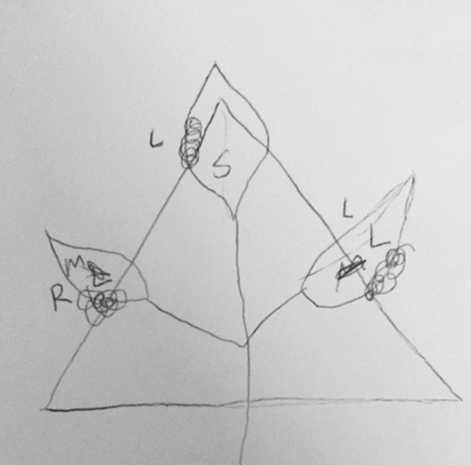
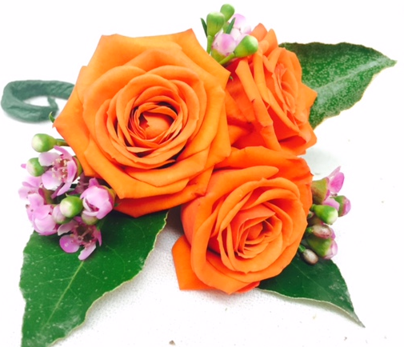
Corsage/Boutouniere
Elements: I really like the colors in this corsage. The bright orange helps draw attention to the focal point while the waxflower adds a splash of different color so the orange won’t be overwhelming while the Elaeangnus helps smooth out the colors.
Principles: I like the dominance in this. The spray rose plays as the leading character in this piece with it’s size and color while the waxflower helps compliment it as well as the foliage.
Plant materials: Spray Rose, Elaeagnus, and waxflower

Slide 7
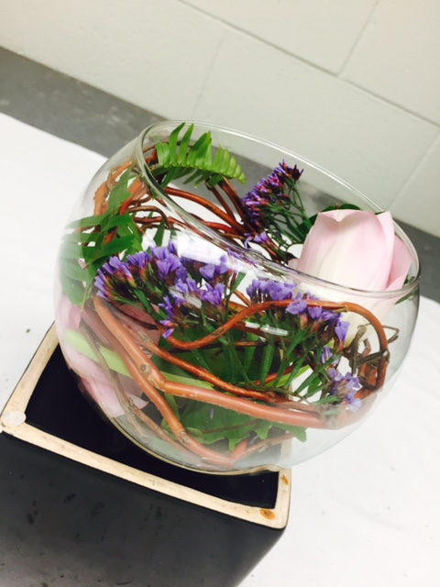
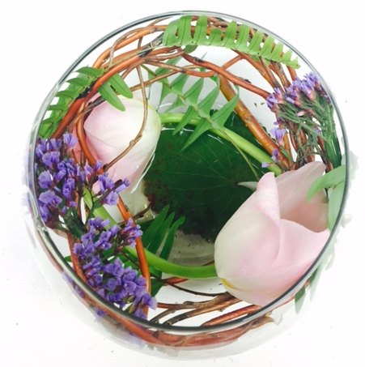
Swirl Vase
Plant material: Curly Willow, Seafoam Statice, Galax, sword fern, and tulips.
Elements: I love the different textures in this design. The glossy rough curly willow go really well with the soft smooth tulips. The ferns help give it a delicate texture.
Principle: I love the harmony in this piece. Although the materials are not all the same texture, size, etc they go really well together. The colors blend well together while the different textures help harmonize the whole piece and creates one uniform mood of nature.

